Slide 1
Why standards are critical: Graphing knowledge by building on well-established standards can look well into the future
Ailie Smith and Marco La Rosa

Slide 2
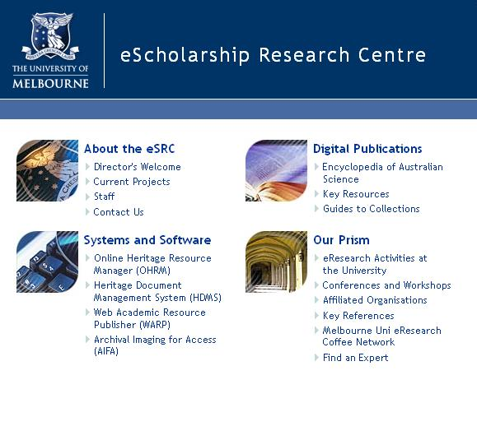
1999 – 2006
Australian Science and Technology Heritage Centre (Austehc)
1985 – 1999
Australian Science Archives Project (ASAP)

Slide 3
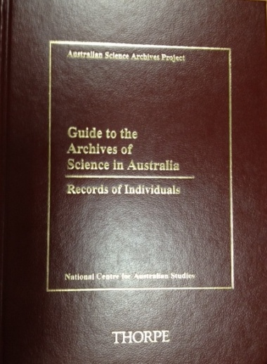
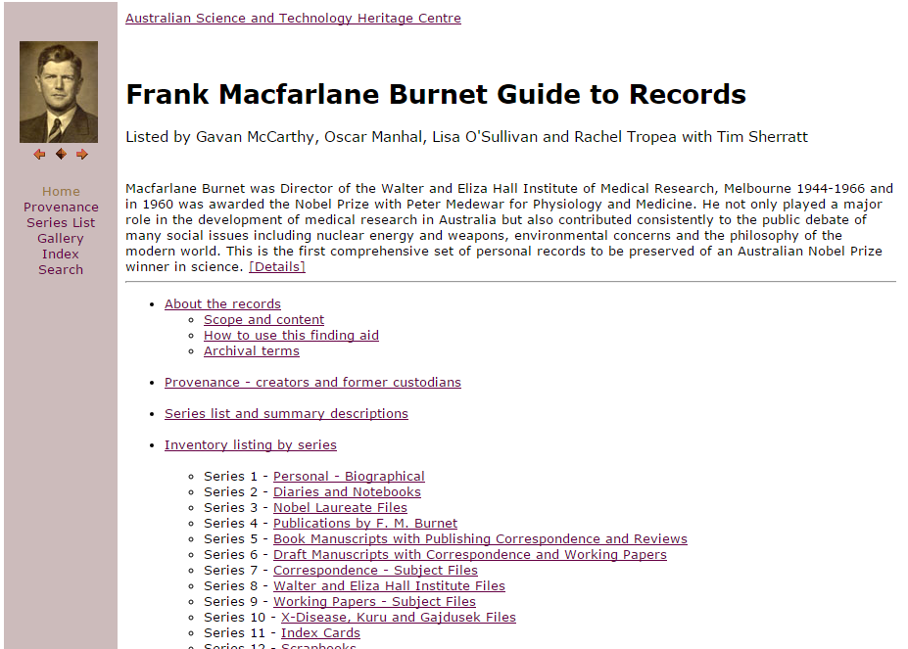
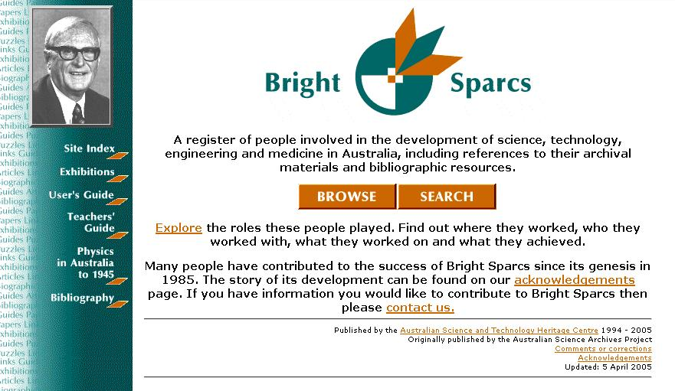

Slide 4
1999 – 2006
Australian Science and Technology Heritage Centre (Austehc)
1985 – 1999
Australian Science Archives Project (ASAP)

Slide 5
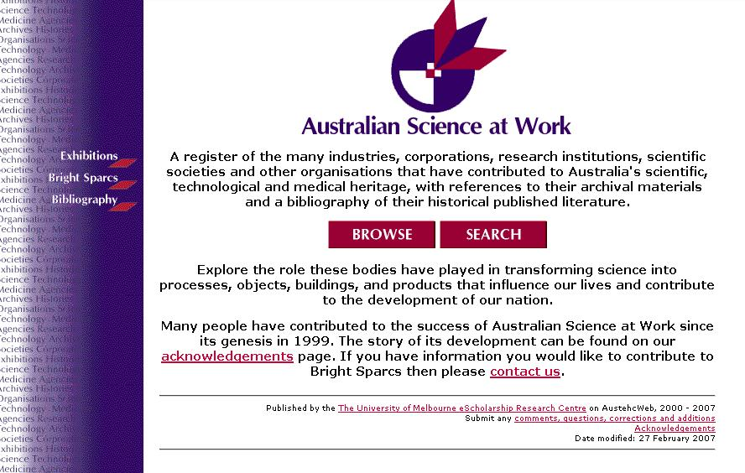
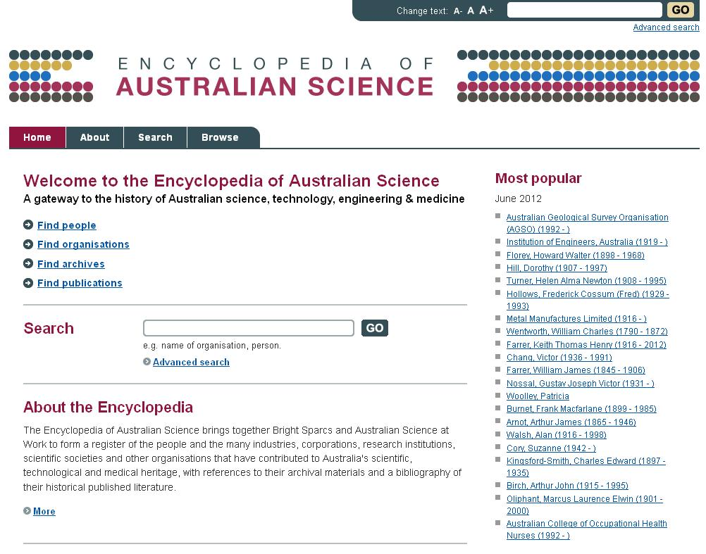

Slide 6
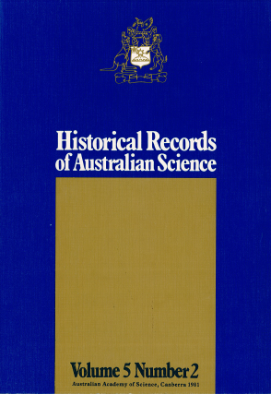
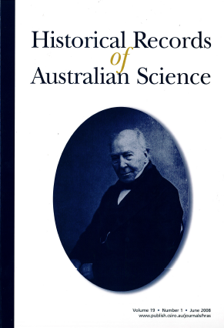

Slide 7
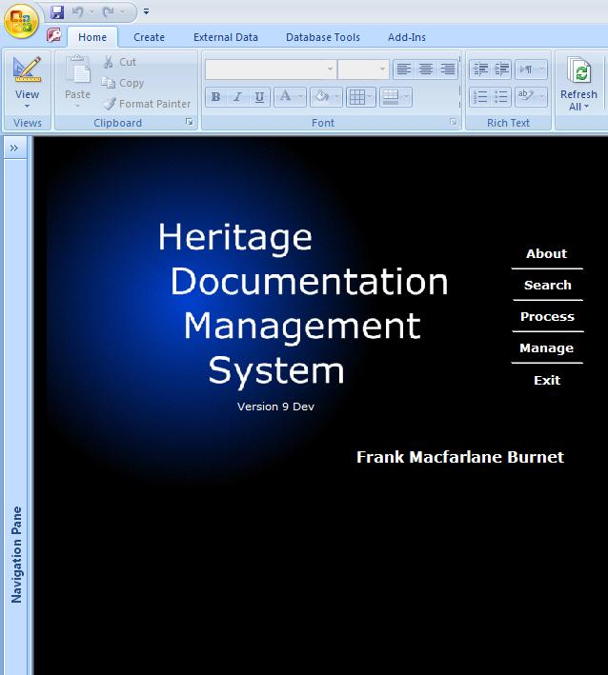
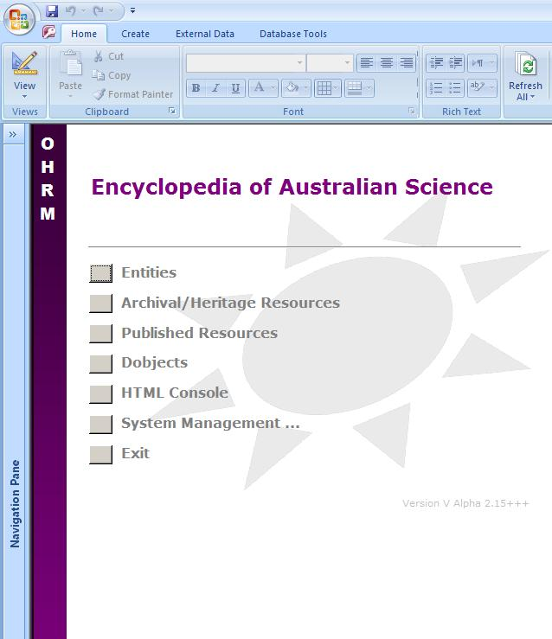

Slide 8
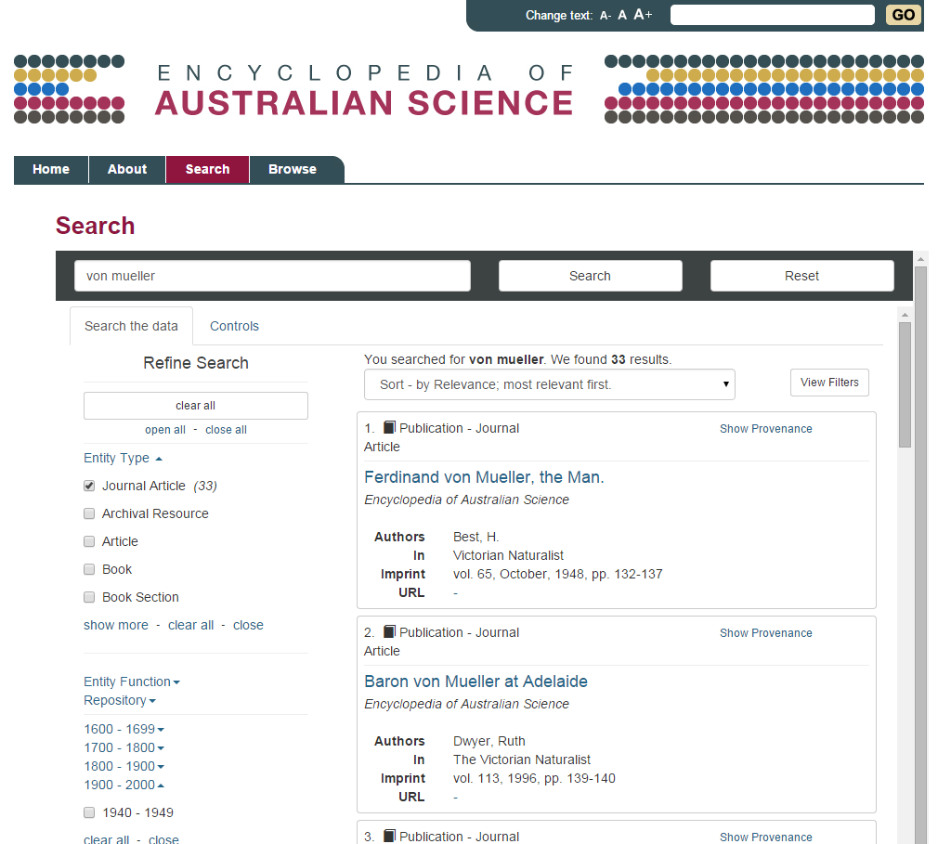

Slide 9
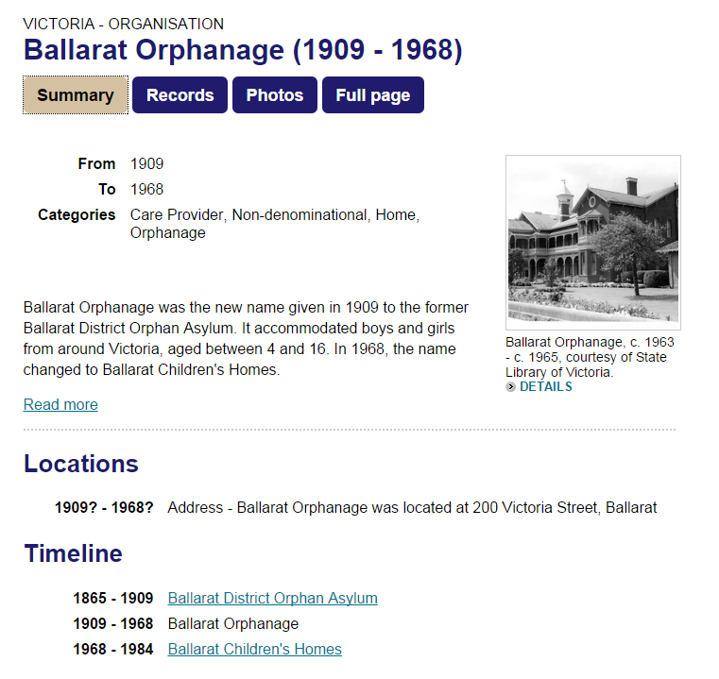

Slide 10
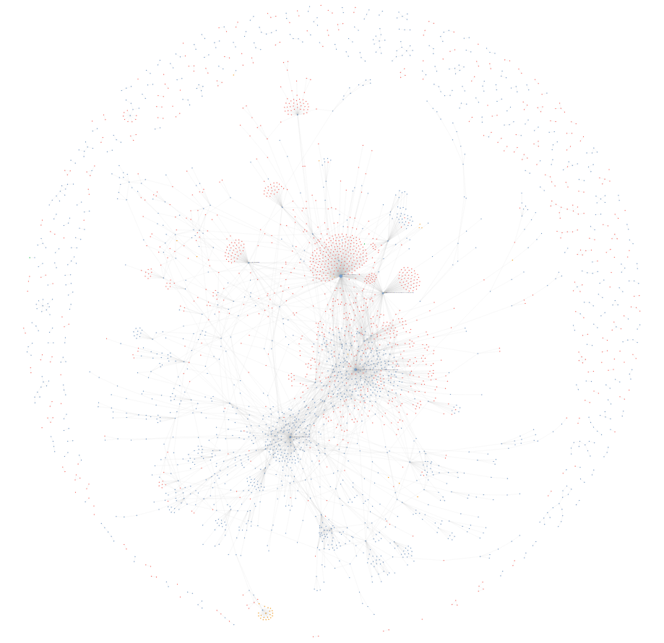

Slide 11
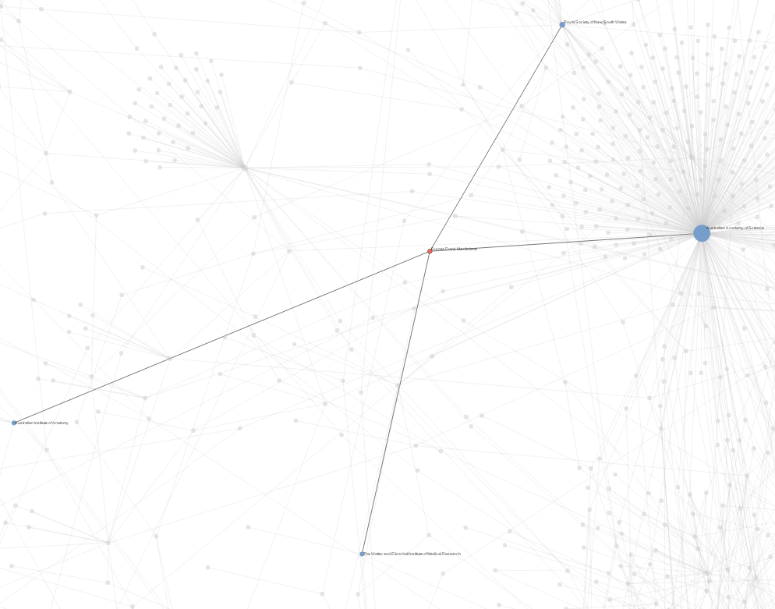

Slide 12
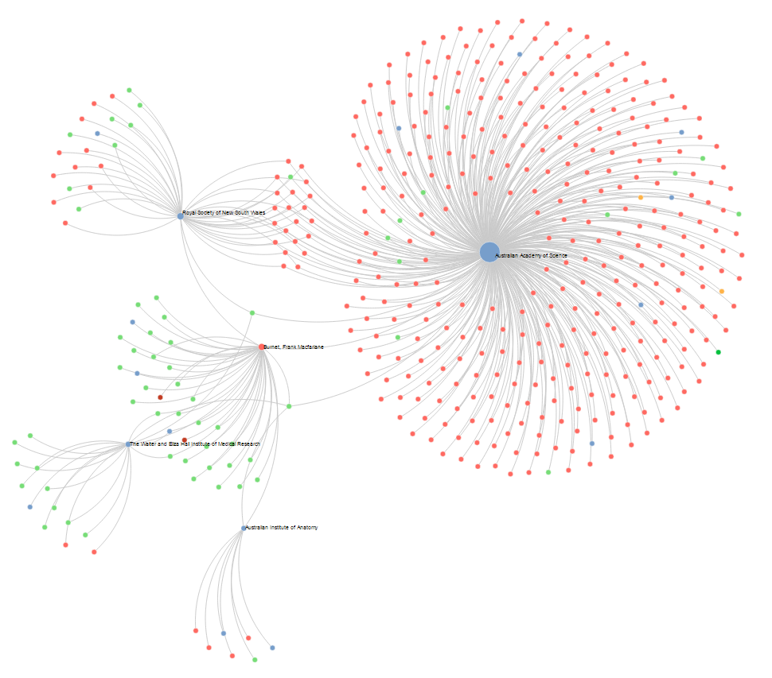

Slide 13
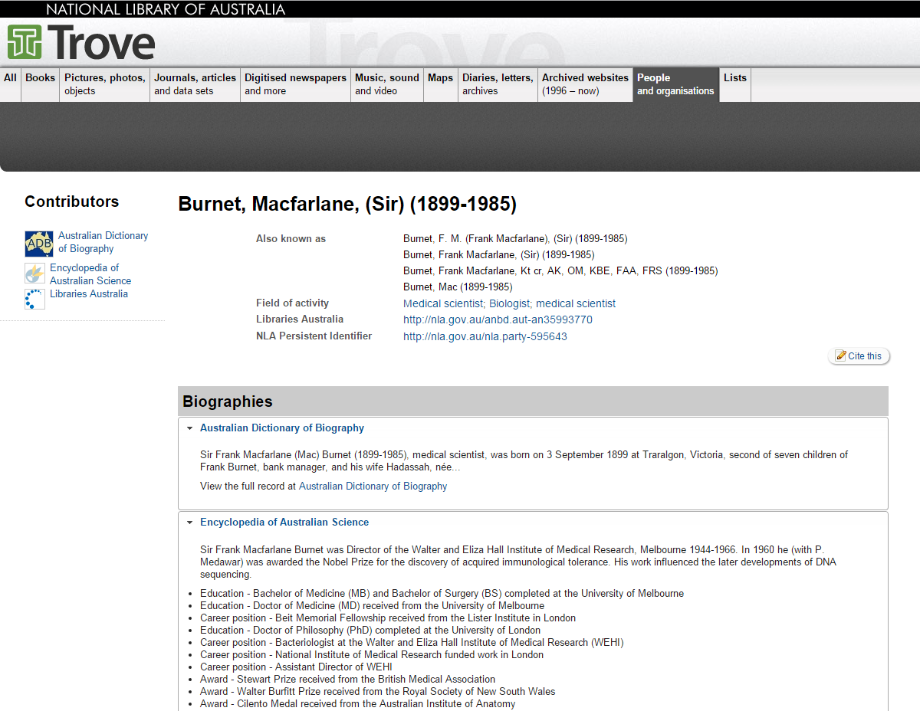

Slide 14
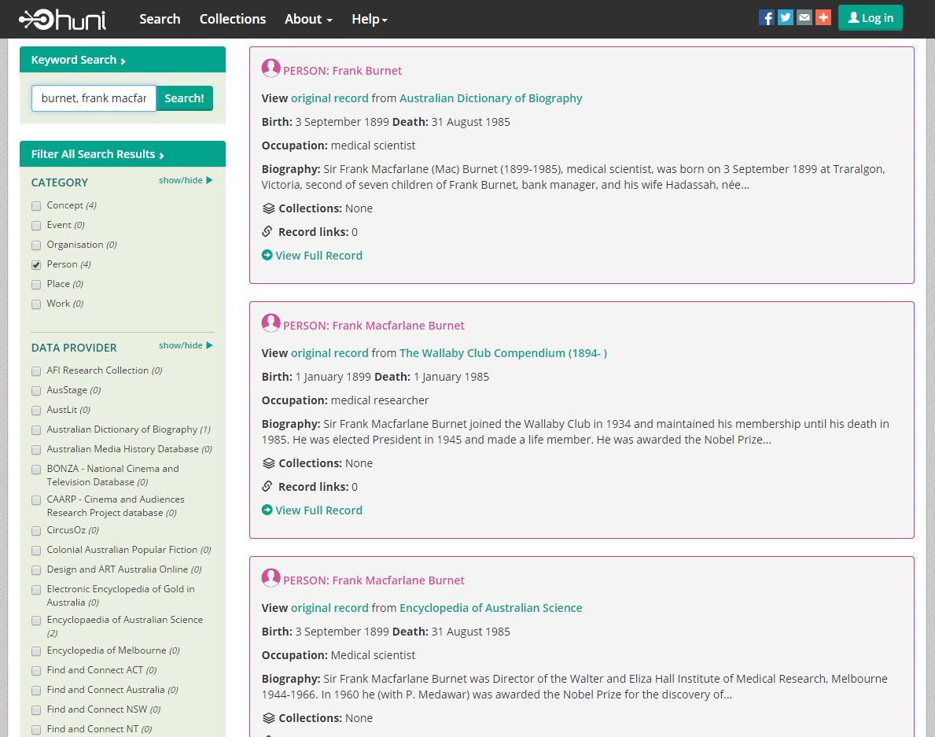

Slide 15
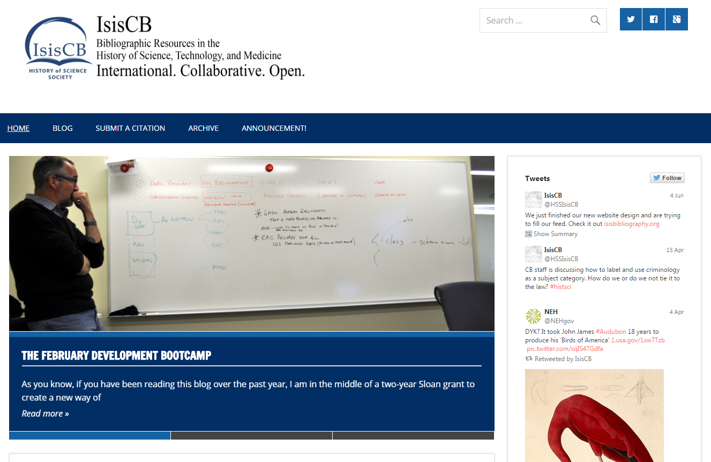

Slide 16
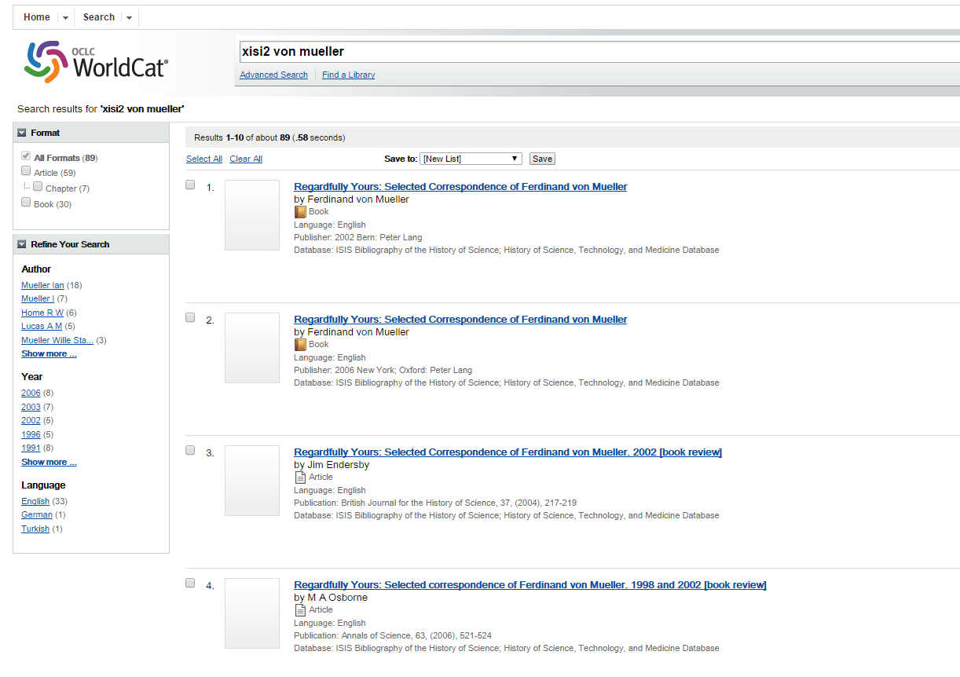

Slide 17
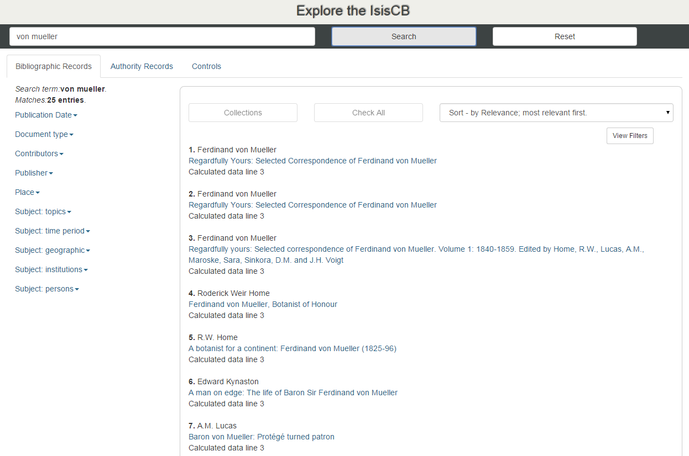

Slide 18
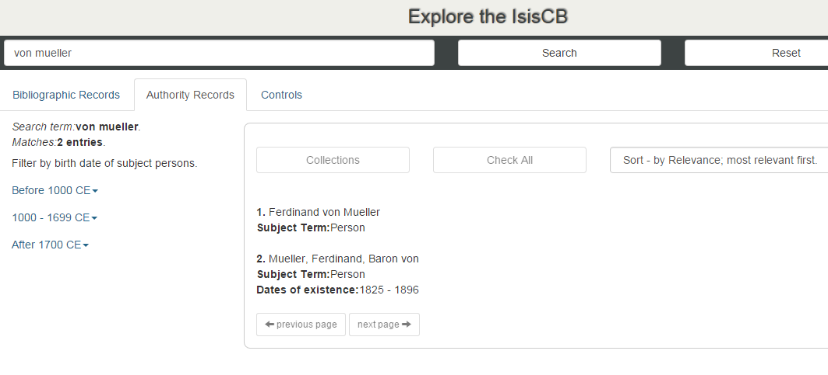

Slide 19
Ailie Smith, eScholarship Research Centre, The University of Melbourne
ailie.smith@unimelb.edu.au
Encyclopedia of Australian Science
http://www.eoas.info
IsisCB
http://isisbibliography.org

