Slide 1
Bibliography as Discipline Map
Rebuilding Data Structure in the Isis Bibliography of the History of Science for Social Network Study
Authors: Stephen P. Weldon¹, Sylwester Ratowt¹, Birute Railiene², John Stewart¹
¹University of Oklahoma, Norman, Oklahoma, United States
²Wroblewski Library of the Lithuanian Academy of Sciences, Vilnius, Lithuania
Presented at DH 2015, Sydney Australia, July 2, 2015, in Panel 3:
“The History of Science in the Age of Networked Digital Humanities”

Slide 2
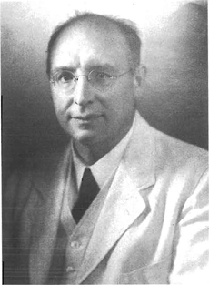
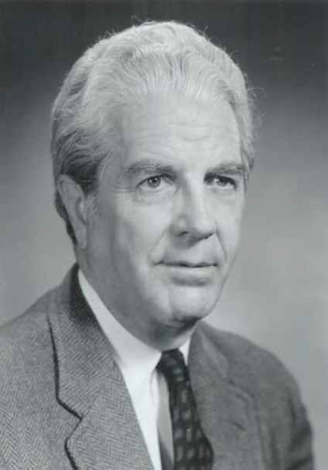
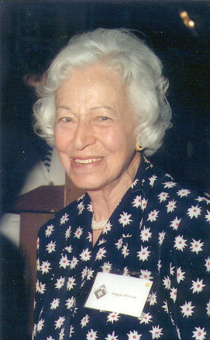
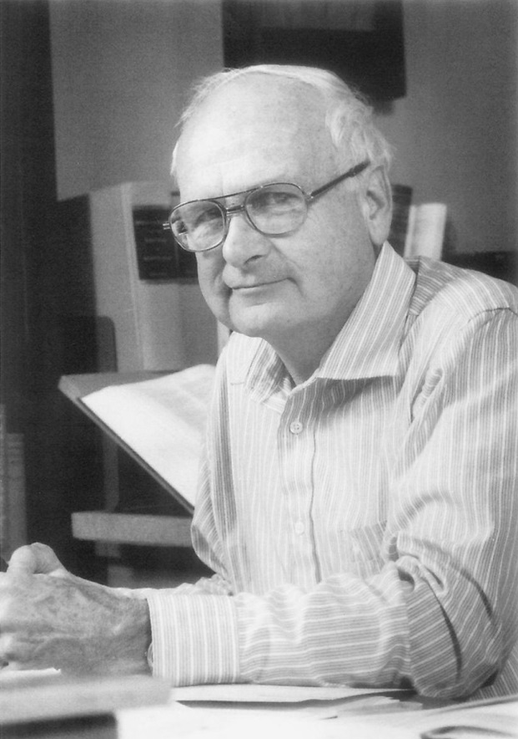
The Isis Bibliography and the Field of History of Science
Bibliographers from 1913 to 1999
George Sarton
Henry Guerlac
Magda Whitrow
John Neu
(http://www.dbnl.org/tekst/hall014gesc01_01/hall014gesc01_01_0029.htm)
(Copyright © 2006 by Division of History of Chemistry of the American Chemical Society. All rights reserved.)
http://www.libsci.sc.edu/bob/isp/whitrow2.htm
Vol. 83, Current Bibliography 1992, pp. ii.
Notes:
The main people responsible for the Isis Bibliography over the past century have been the four individuals indicated here. Sarton began the Bibliography in 1913 and edited it until he retired in the early 1950s. After that it was compiled by a committee under the direction of the editor of the journal Isis. Henry Guerlac, shown here, was the head of the committee responsible for setting up a new classification scheme. This was the scheme used in all of the annual bibliographies until 1999. Magda Whitrow was instrumental in compiling and reediting all of the citations in the bibliographies that had been published between 1913 and 1965. Her Cumulative Bibliography brought all of those works together six volumes in a completely reindexed system. She used a new faceted classification system of her own devising. Between 1968 and 1999, John Neu produced all of the annual bibliographies. He also produced three separate cumulations for the decades 1966-1975, 1976-1985, and 1986-1995, all of these cumulative volumes used Magda Whitrow’s classification schema.

Slide 3
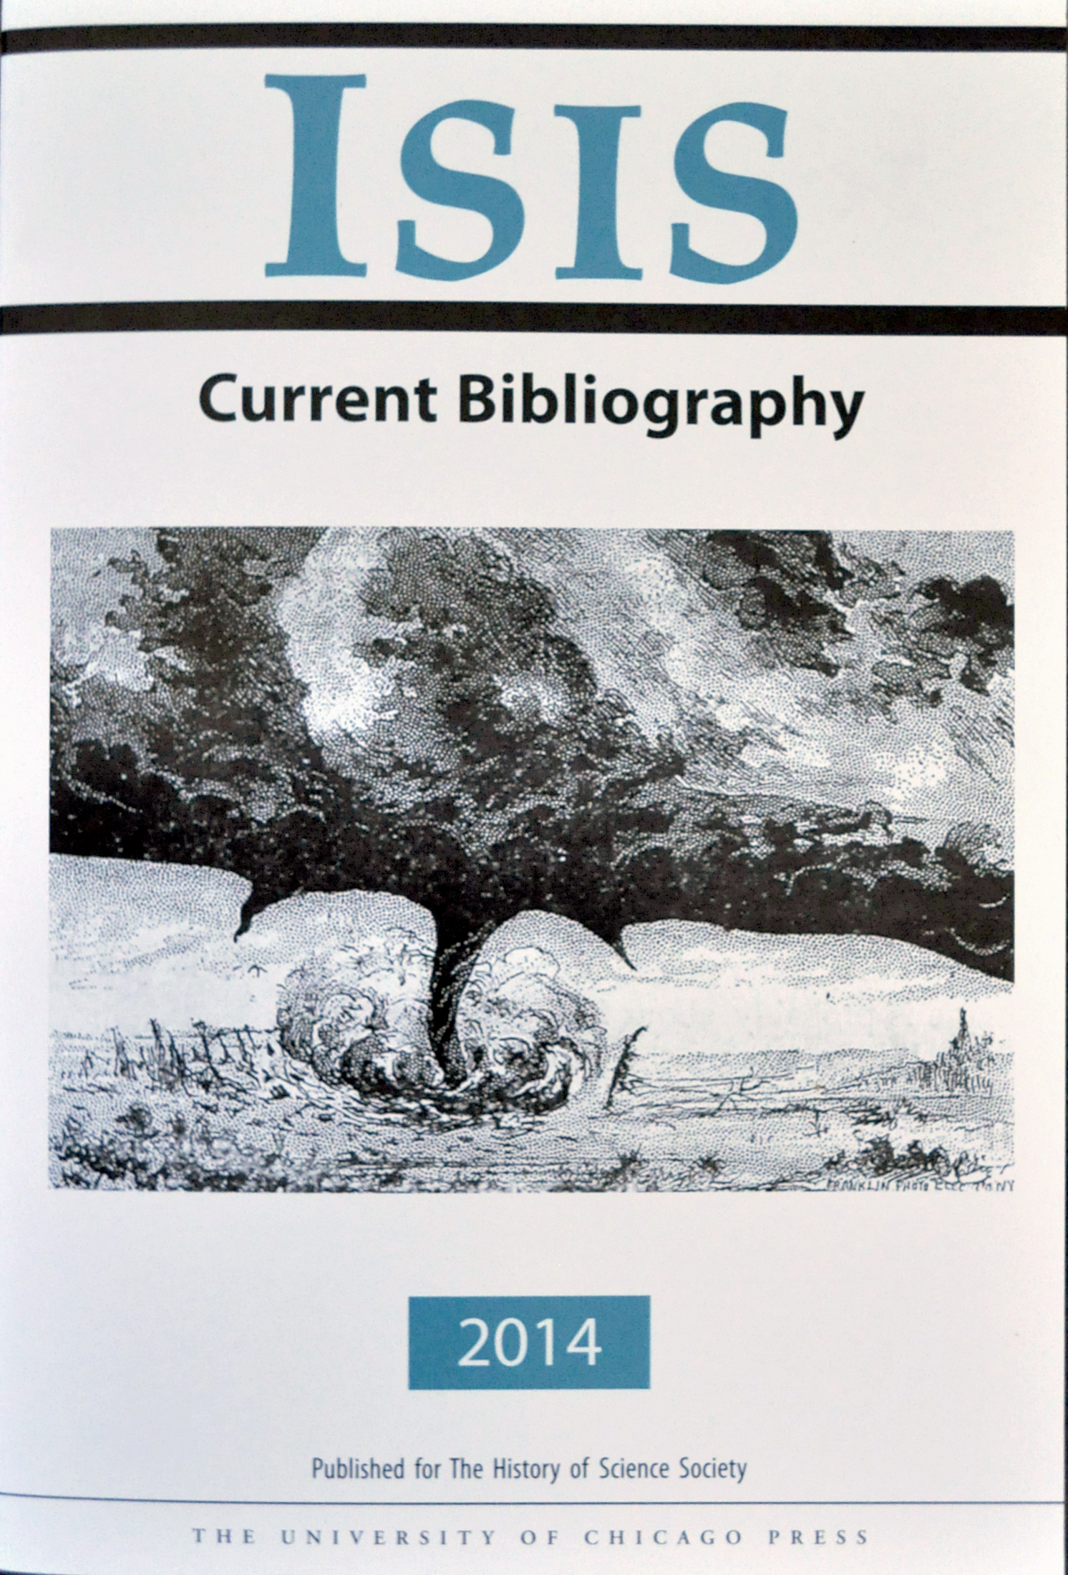
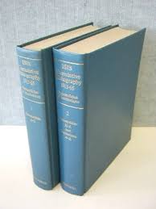
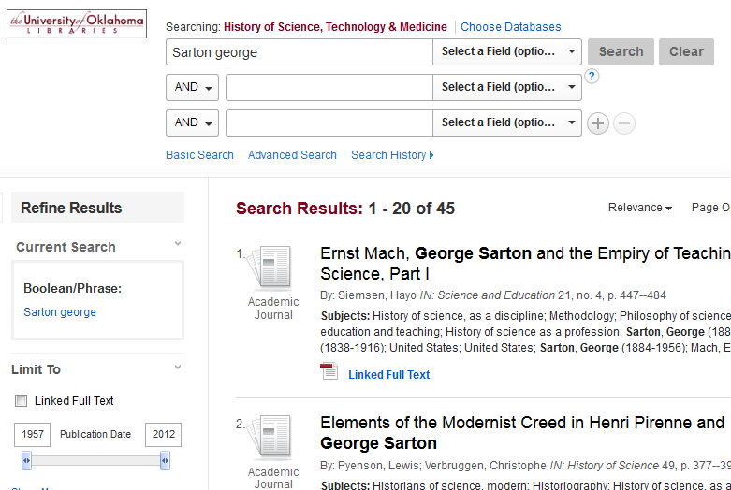
The Forms of the Publications of the Isis CBs
Annual Volumes
Cumulative Volumes
HSTM Database (hosted by EBSCO)

Slide 4
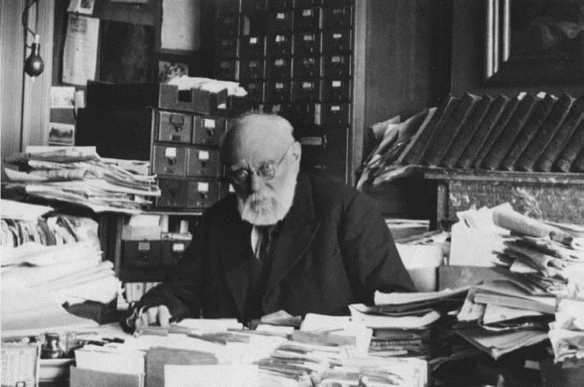
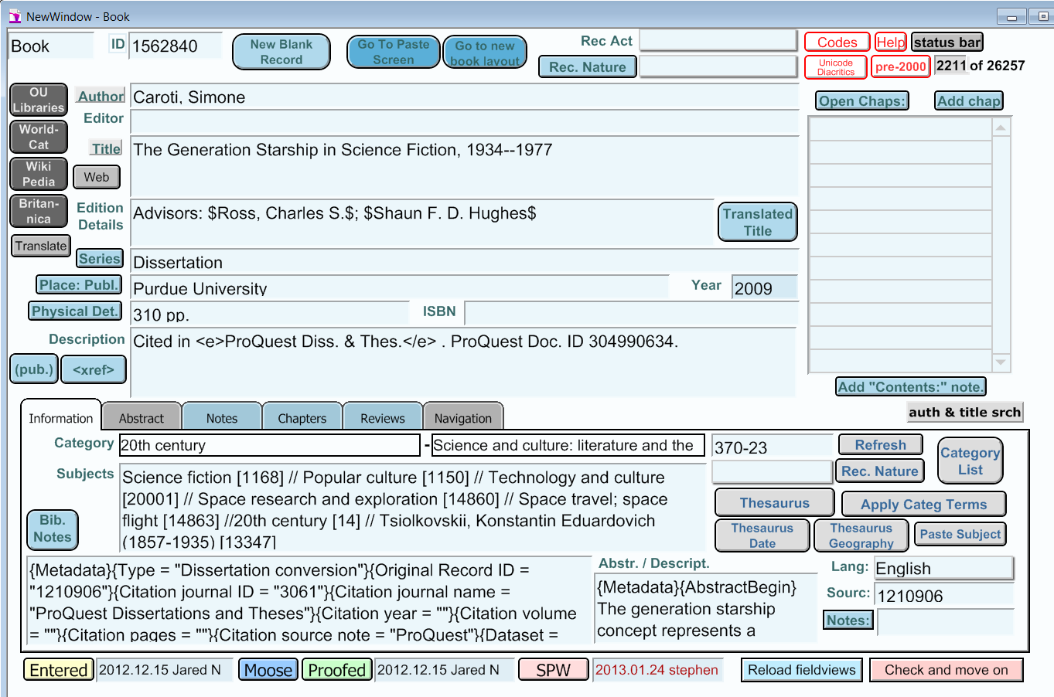
The Collection and Maintenance of the Data
Collection of citations has not changed much over the years.
Since 1974, the data has been put into a database rather than on cards.
Maintenance of the data has now become entirely database driven.
For the pre-1974 data, I am creating new digital preservation formats, TIFF, JPG, PDF, and OCR text files.
Preservation now focuses on digital archives.

Slide 5
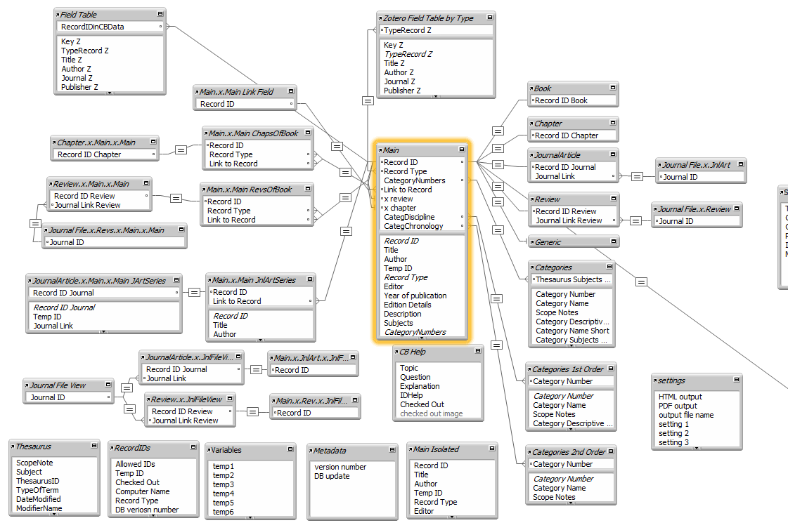
Typical Bibliographic Database Structure: IsisCB 2002 System
The main tables deal with citation maintenance.
The sub-tables provide fields specific to different kinds of citations.
The thesaurus is an unlinked list of controlled vocabulary. Thesaurus entries are copied into the subject field of the citation entry. There is no dynamic linking.
Authors, editors, etc. are not controlled and are entered as found in the citation reference.

Slide 6
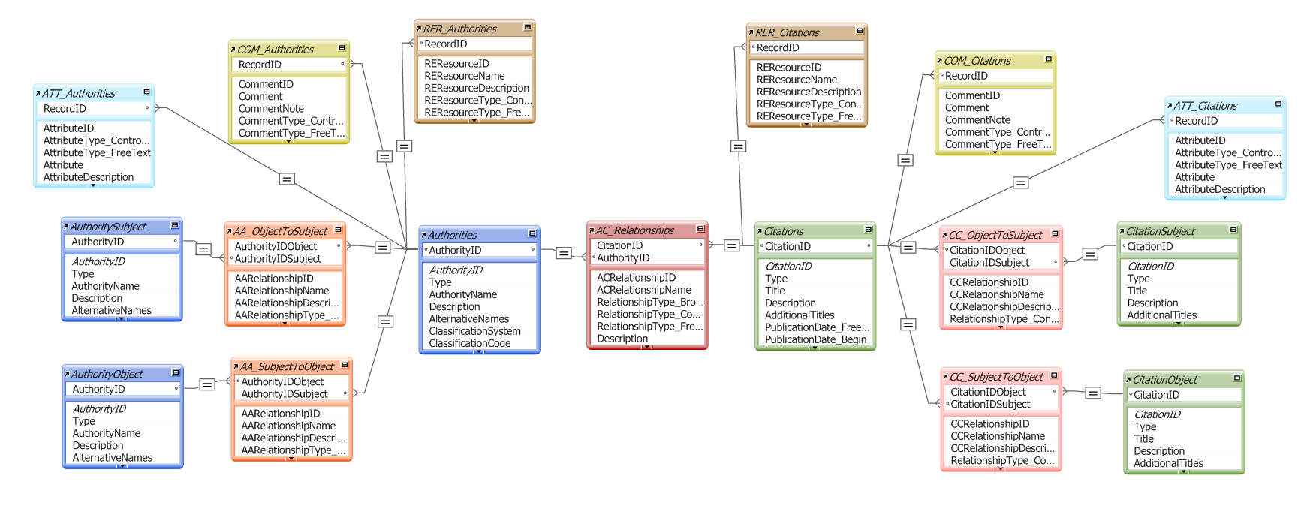
New Informatics: IsisCB 2015 System
The new database structure is structured around the relation table that links citations and authorities. Authorities are tracked and managed in the same way that citations are.

Slide 7
Underlying Concepts of the New Informatics
Standards-based: We are adding new types of exports. EAC-CPF and MODS 3.5 (XML-based schemas) are at the heart of the new system. New formats can be added more easily as we have more flexibility with the fields.
Flexible: The types of authorities and types of references are not fixed. We have added new types of digital records and more complex authority types.
Extensible: We can build links internally and externally. The external links are easily added to both citations and authorities as Open Linked Data.
Relationship-centered: We have called the informatics the Relation-as-Entity Model. The relationship records are not simple join tables. They are tracked and modifiable. They contain data that is not present in either of the other two tables.

Slide 8
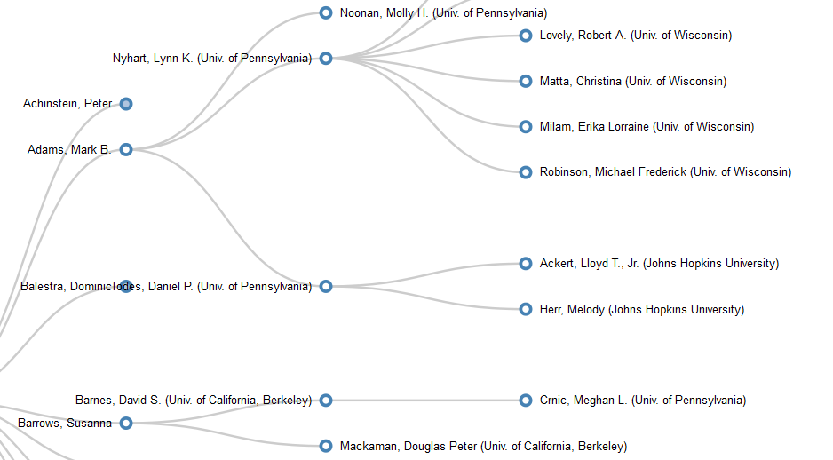
New Analytics Now Possible with New Informatics:
Dissertations in the IsisCB from 1975 to 2015
Visualizations have been done in D3, using exported data in very simple formats.
This visualization shows the academic lineage as found in dissertation records.
To create this we produced a three-column csv: listing dissertation authors, institutions, and advisors.

Slide 9
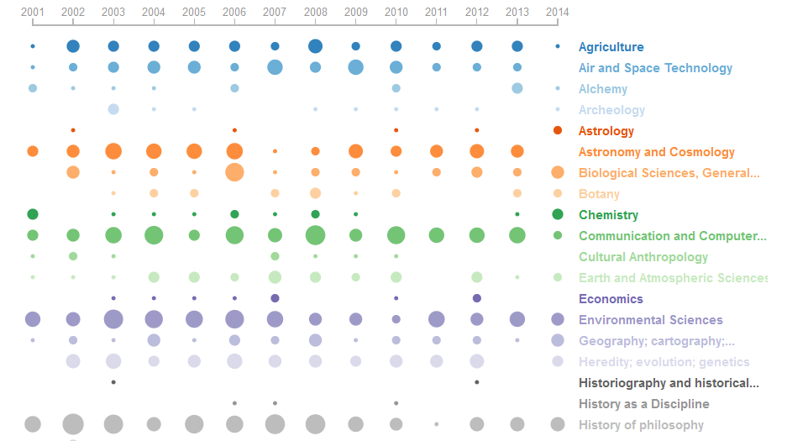
New Analytics Now Possible with New Informatics:
Dissertations in the IsisCB from 1975 to 2015
This visualization shows the frequency of classifications of dissertations since 2001.
Adapted from Asif Rahman’s visualizations of frequency of concepts in neuroscience journals.
These visualizations are based on JSON files with the year-by-year frequency counts of each category.

Slide 10
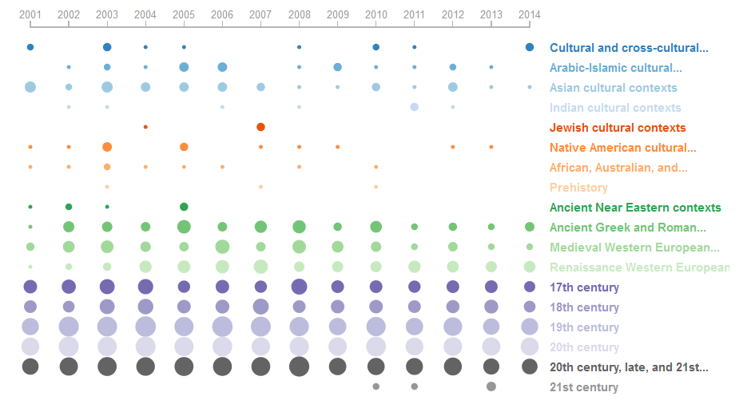
New Analytics Now Possible with New Informatics:
Dissertations in the IsisCB from 1975 to 2015
A similar type of visualization as previously noted for regional and time classifications.
Note the relative paucity of studies on science in the Indian, Jewish, Native American, and African cultural contexts, especially as compared to the frequency of dissertations on Western science in the last two centuries.

Slide 11

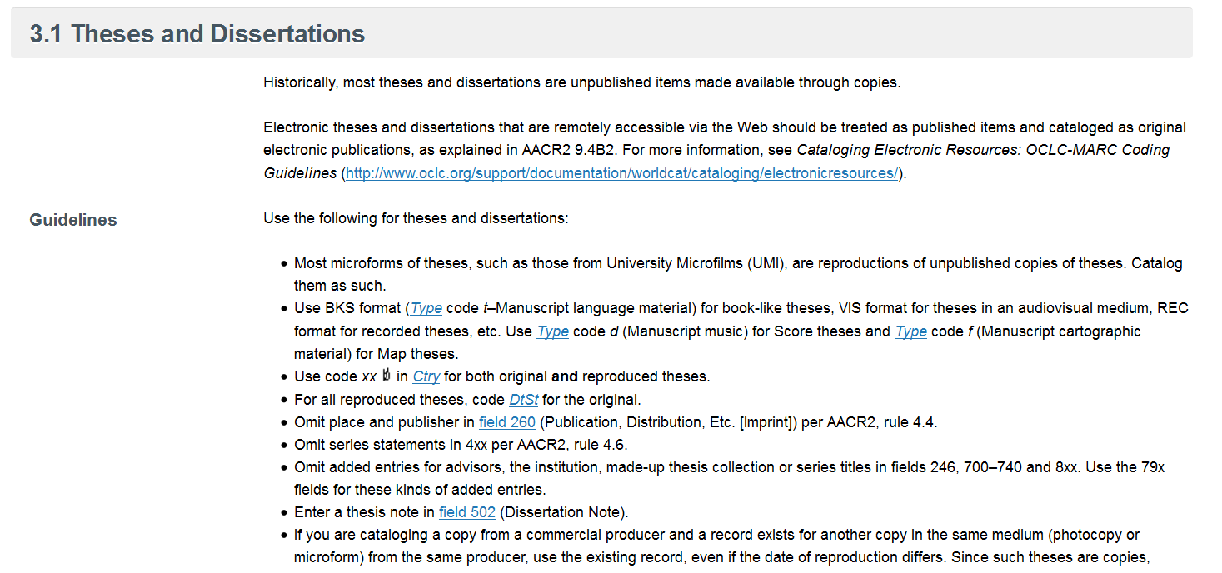
Implications for the Larger Community: Establishing New Mandates
The IsisCB focus on dissertations has made it necessary to begin to encourage changes in standards.
The Commission on Bibliography and Documentation is urging OCLC to modify its standards.

Slide 12
Thank You.

